Slide 1
Getting to the ”Heart” of the issue!
September 2022

Slide 2
Cardiovascular diseases (CVDs)
Are the NUMBER ONE cause of death globally
Account for just under 18 MILLION deaths annually
This represents 31% of all deaths
One third of deaths occur prematurely in patients under 70 years old

Slide 3
Cardiovascular diseases (CVDs)
Early detection and management is critical for patients to improve outcomes
This is where machine learning can help!
Using 11 common features across 5 combined datasets, our goal is to create a model that can help predict CVDs for early detection

Slide 4
Cardiovascular diseases (CVDs)
Among the features included for analysis were:
Age
Gender
Resting BP
Cholesterol
Maximum Heart Rate
Exercise-Induced Angina

Slide 5
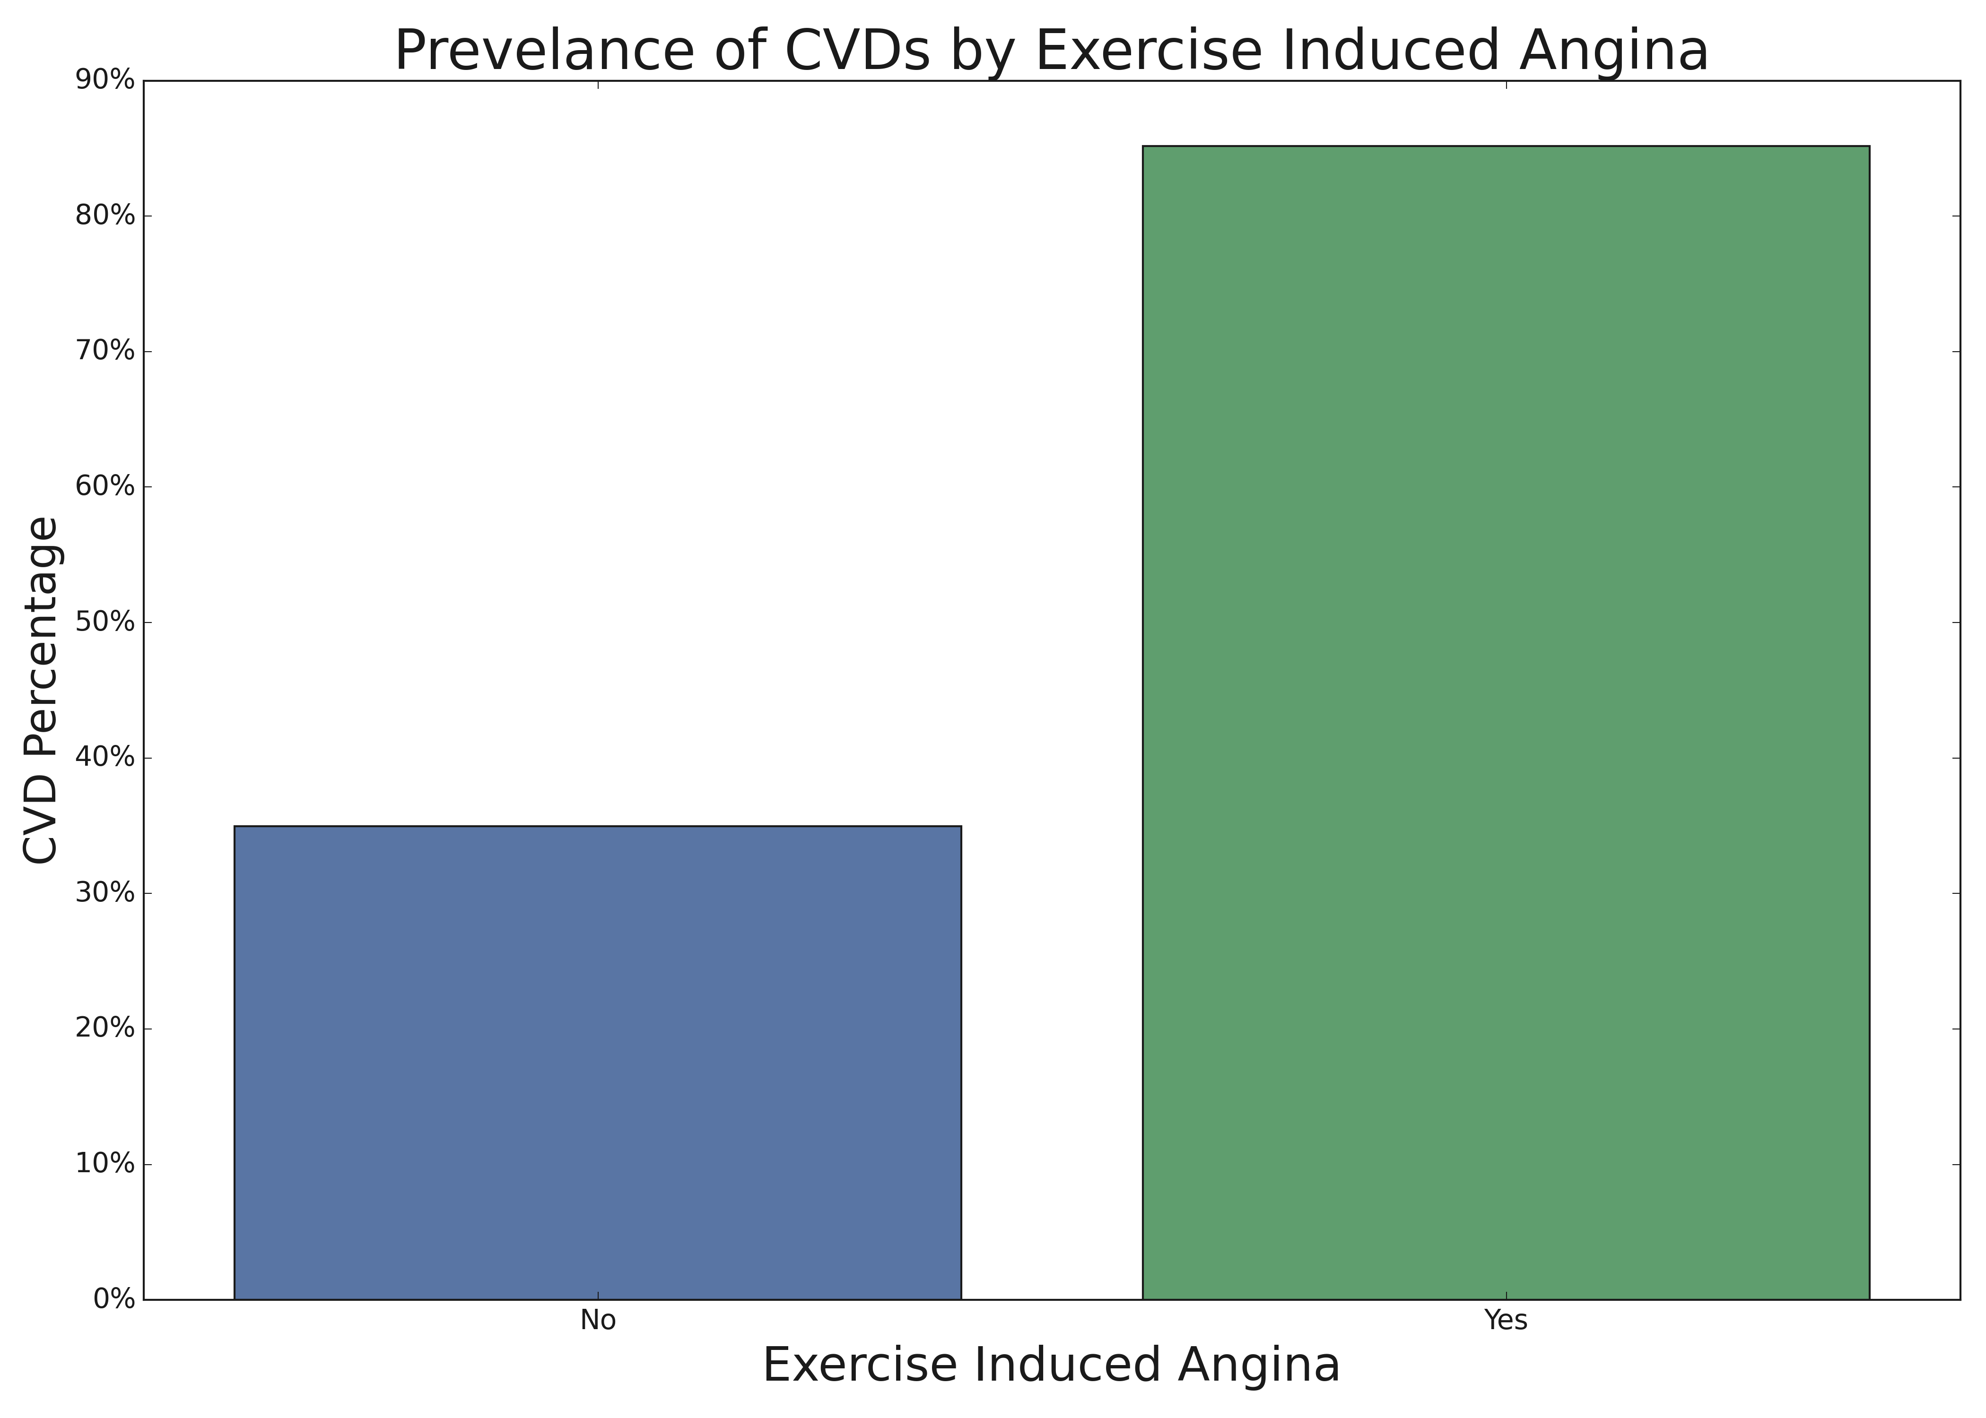
Initial Analysis

Slide 6
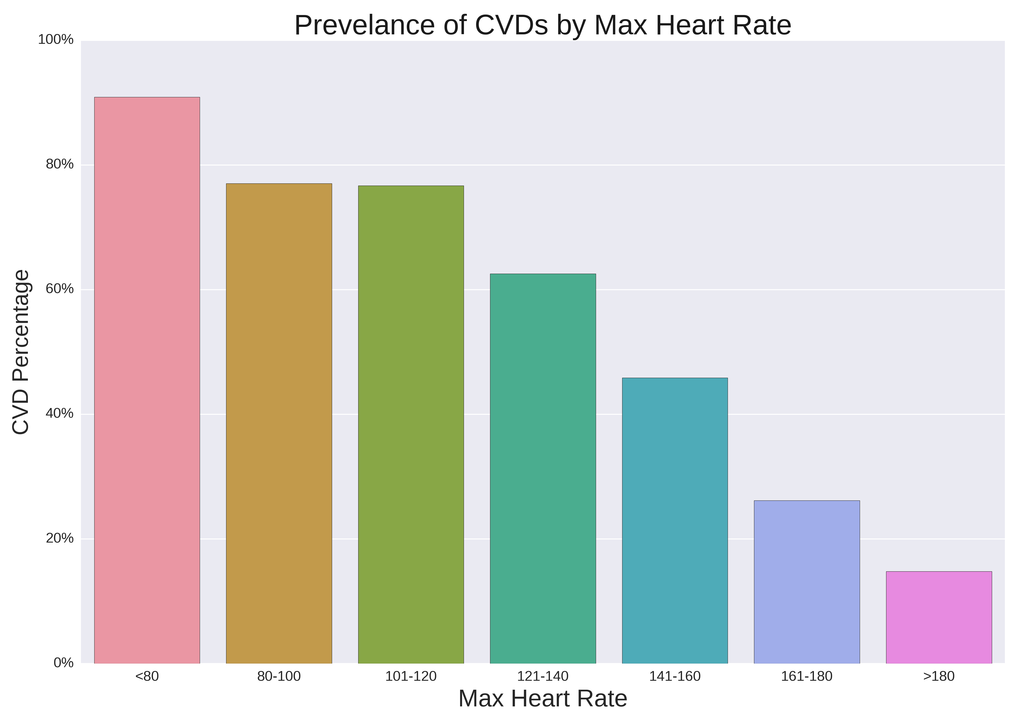
Initial Analysis

Slide 7
Cardiovascular diseases (CVDs)
After creating and hyper-tuning our machine learning model, we were able to achieve the following:
Overall accuracy of just under 90%
Positive-Class Precision of 93%
Positive-Class Recall of 90%
This model ensures a high degree of accuracy, with limited false negatives that would leave a patient without treatment

Slide 8
Recommendations
Move forward with the model as a first line of defense for incoming patients
Positive results from the model can undergo further testing to verify CVD status

Slide 9
Getting to the ”Heart” of the issue!
September 2022

